Slide 1
Customer Segmentation Analysis Insights
File created on: 9/27/2023 7:48:17 AM

Slide 2
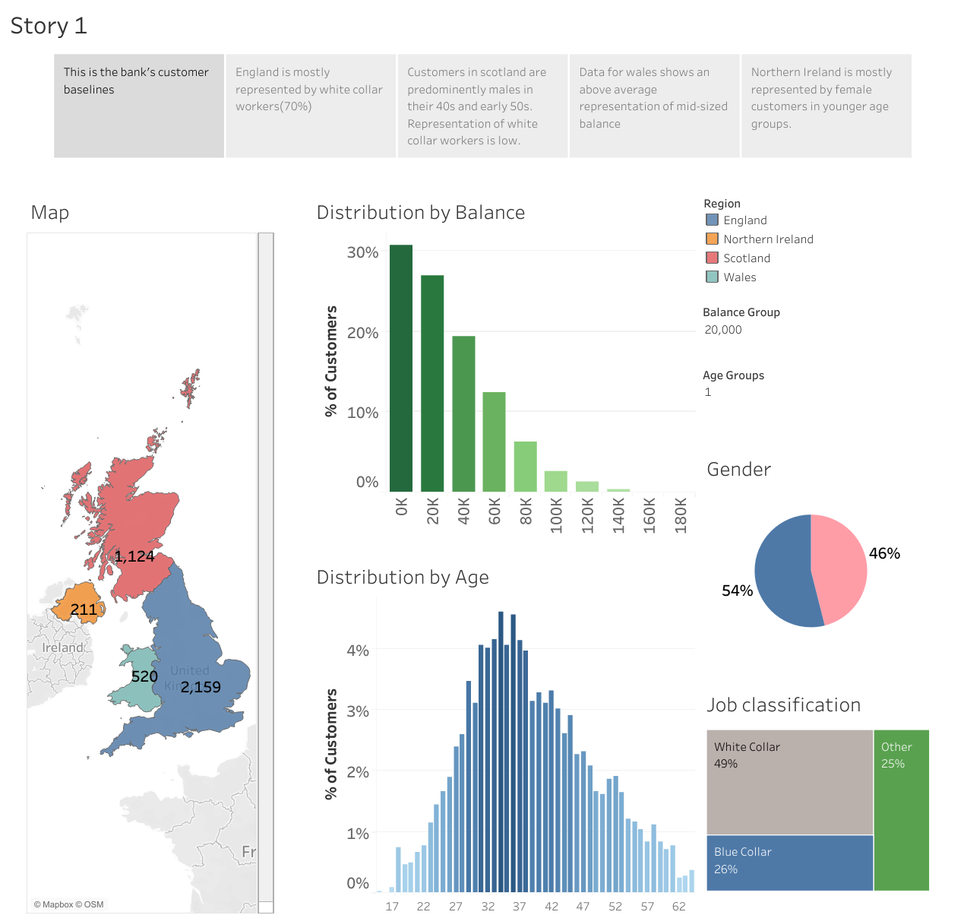

Slide 3
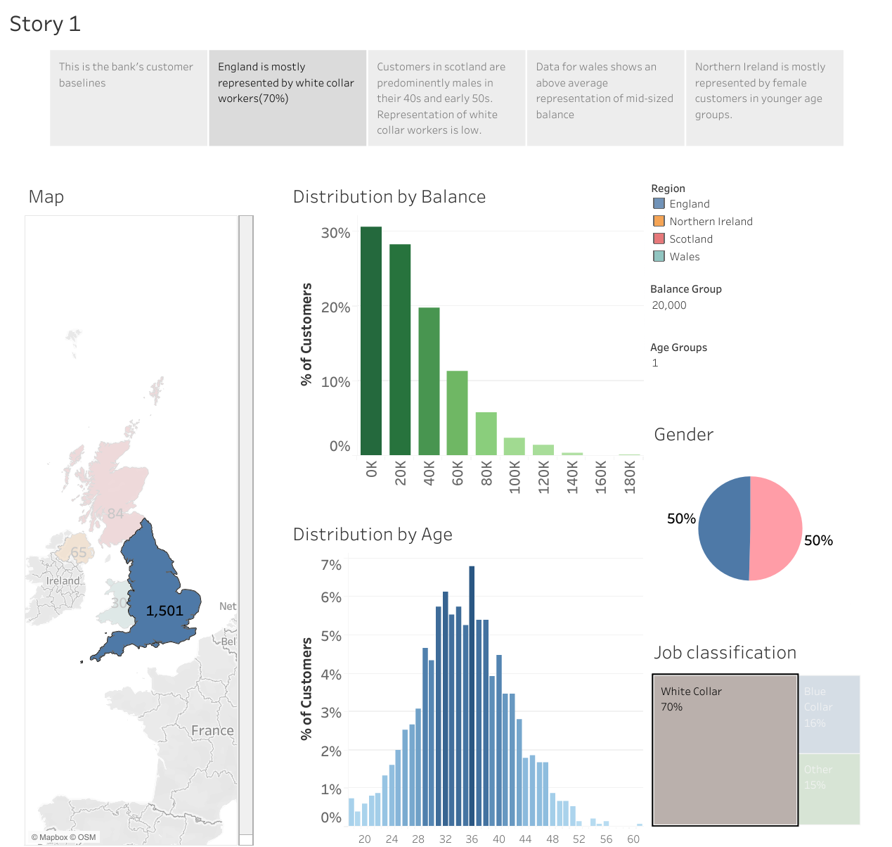

Slide 4
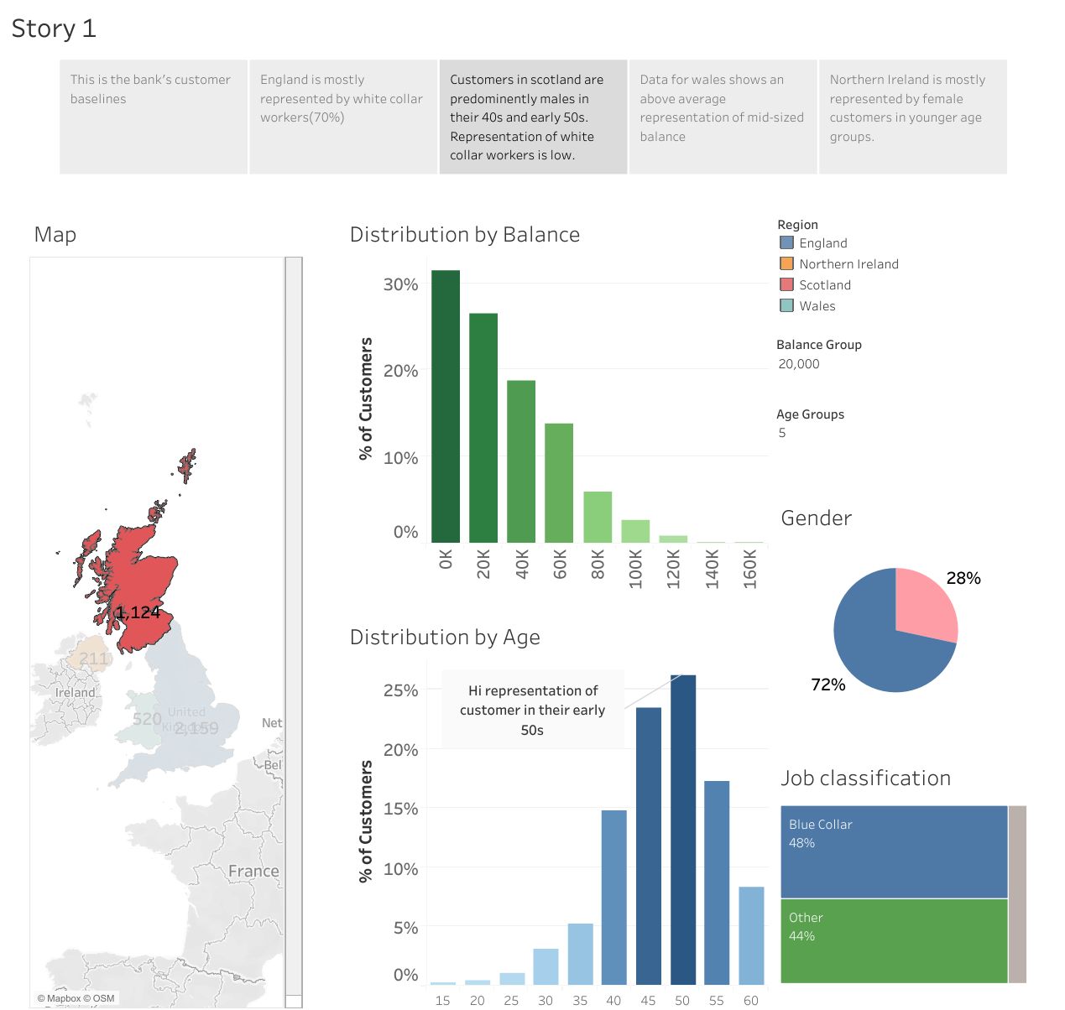

Slide 5
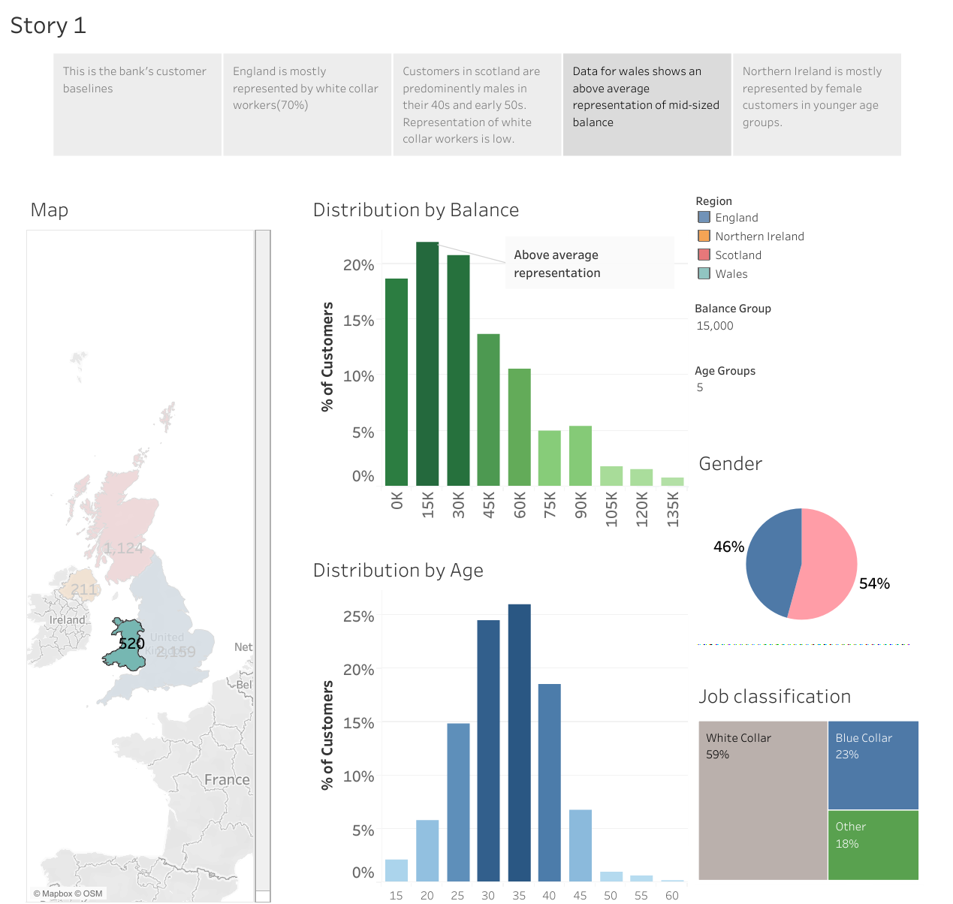

Slide 6
